Slide 1
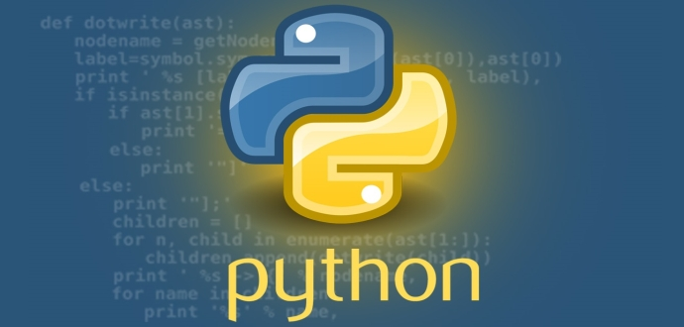
Welcome
Introduction to Python Programming

Slide 2
Schedule
Time | Activity
9:30 – 10:45 | Review Anaconda/Jupyter/Python Data Types: Numbers, Strings, Boolean Variable Assignment Casting Attempt Exercise 1 and 2
10.45 – 11:00 | Break
11:00 – 12:15 | Lists, Tuples, Dictionaries Sequence, Selection, Iteration Functions and Parameters Attempt Exercise 3,4,5 and 6
12:15 – 12:30 | Prep for next day

Slide 3
Why learn Python?
Well loved by all - WHY ?
Free, Simple, Portable.
Loads of resources (libraries)/materials/support to help you develop.
A high-level language and can do complex tasks. For example, web development, data analysis, artificial intelligence, games, desktop apps.
The 2018 Stack Overflow Developer Survey ranked Python as the 7th most popular and the number one most wanted technology of the year.

Slide 4
Anaconda?
Anaconda is a python and R distribution. It aims to provide everything you need (Python-wise) for data science "out of the box".
It includes:
The core Python language
100+ Python "packages" (libraries)
Spyder (IDE/editor - like PyCharm) and Jupyter
conda, Anaconda's own package manager, used for updating Anaconda and packages

Slide 5
Python Online
Good for simulating scripts (lines of code)
https://repl.it/repls/OnerlookedBestWrapper
Good for visualising execution of iteration
http://pythontutor.com/visualize.html#mode=edit
This is fast and reliable (a bit tested by me)
https://www.python.org/shell/
To open titanic.csv from github put in the following code
Import pandas as pd
url='https://raw.githubusercontent.com/salihadfid1/Intro-Python/master/titanic.csv’
df = pd.read_csv(url, index_col=0)

